Slide 1
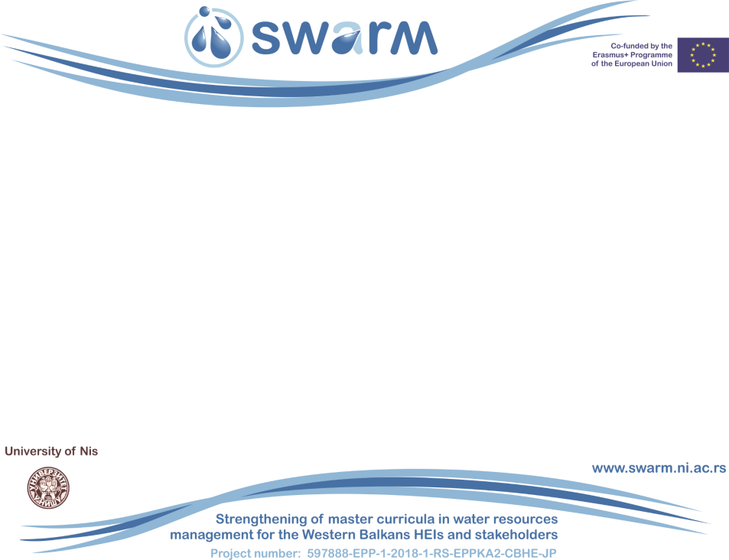

SWARM project
Jelena Đokić
UPKM
Cluster Meeting on `Impact of Erasmus+ CBHE projects on reform and modernization of Higher Education system in Kosovo`
3rd December 2020 Prishtina.
This project has been funded with support from the European Commission. This publication reflects the views only of the author, and the Commission cannot be held responsible for any use which may be
made of the information contained therein.

Slide 2



Basic Information
Contract number Project acronym Project name
597888-EPP-1-2018-1-RS-EPPKA2-CBHE-JP SWARM
Strengthening of master curricula in water resources management for the Western Balkans HEIs and stakeholders
15th November 2018 - 14th November 2021
Erasmus+ Call for Proposals EAC/A05/2017
931,289.00 €
University of Niš, Serbia Univerzitetski trg 2, 18000 Niš, Serbia www.swarm.ni.ac.rs swarmuni@gmail.com
Project duration Programme Total cost
Coordinator
Project website
Project e-mail
Strengthening of master curricula in water resources management for the Western Balkans HEIs and stakeholders
www.swarm.ni.ac.rs

Slide 3
Objectives
Overall Objective: Education of experts for water resources management in the Western Balkans (WB) in line with the national and EU policies.
Improve the level of competencies and skills in WB HEIs by developing new and innovative master programmes in the field of water resources management (WRM) in line with the Bologna requirements and national accreditation standards by October 2021
Design and implement seven new and up-to-date laboratories in WB partner HEIs in cooperation with EU project partners by November 2019
Develop and implement LLL courses for the water sector in
line with EU Water Framework Directive by January 2021
Strengthening of master curricula in water resources management
for the Western Balkans HEIs and stakeholders
www.swarm.ni.ac.rs

Slide 4





Consortium
EU partners
University of Natural Resources and Life Sciences, Vienna (BOKU, Austria) NorwegianUniversity of Life Sciences (NMBU, Norway)
Aristotle University of Thessaloniki (AUTh, Greece)
University of Architecture, Civil Engineering and Geodesy (UACEG,
Bulgaria)
University of Rijeka, Faculty of Civil Engineering (UNIRIFCE, Croatia)
Universidade de Lisboa (UL, Portugal)
Associated partner
SOFIYSKA VODA AD
Association for Water Technology and Sanitary Engineering
Association Resource Aarhus center in B&H
Regionalni vodovod Crnogorsko primorje
Strengthening of master curricula in water resources management
for the Western Balkans HEIs and stakeholders
www.swarm.ni.ac.rs

Slide 5








Consortium
Western Balkan partners
University of Niš (UNI, Serbia)
University of Novi Sad (UNS, Serbia)
University of Sarajevo (UNSA, Bosnia and Herzegovina)
Dzemal Bijedic University of Mostar (UNMO , Bosnia and Herzegovina) University of Pristina in Kosovska Mitrovica (UPKM, Kosovo*)
Technical College of Applied Sciences Urosevac with temporary seat in
Leposavic (TCASU, Kosovo*)
University of Montenegro (UoM , Montenegro)
Public Water Management Company ‘’Vode Vojvodine’’ (PWMC VV, Serbia)
Strengthening of master curricula in water resources management
for the Western Balkans HEIs and stakeholderswww.swarm.ni.ac.rs

Slide 6
Outcomes
Report on WB regional issues related to WRM, and EU water policies and innovation
recommendations and legislation in water sector
Report on master curricula related to WRM in EU and WB partner countries
Workshop on innovative practices in the EU water sector: barriers and opportunities
Report on innovative practices for WRM in EUCatalogue of competencies
Report on development of specific competencies and learning outcomes of curricula
Theme-based training of teaching staff for acquiring new teaching and learning methods (UACEG, NMBU, UNIRIFCE, AUTh, UL, BOKU)
7 laboratories equipped
Report on LLL courses for professionals in EU water sector
Survey of water sector needs in WB
Register of companies in the field of WRM in the WB countries
Handbook for training in water resources management
Strengthening of master curricula in water resources management for the Western Balkans HEIs and stakeholders
www.swarm.ni.ac.rs

Slide 7
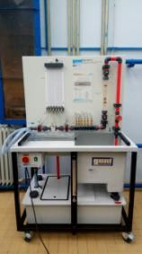
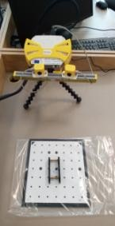
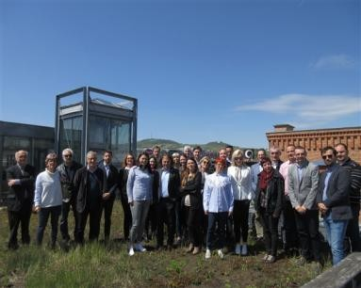
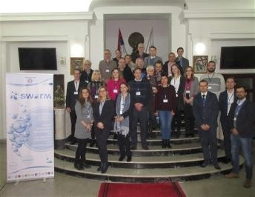
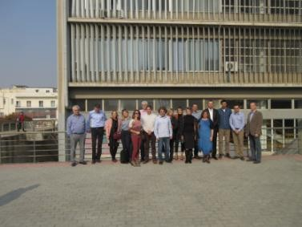
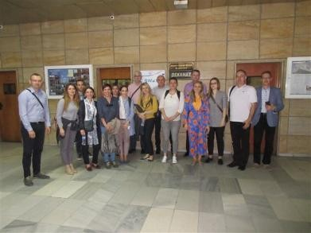
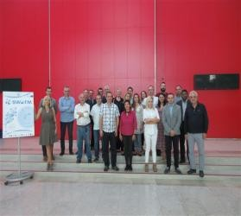
Strengthening of master curricula in water resources management for the Western Balkans HEIs and stakeholders
www.swarm.ni.ac.rs

